Slide 1
SmartBiz Pro ERP
Funding Proposal Summary • 2026-01-13
Offline-first, modular ERP

Slide 2
The Problem
Connectivity failures disrupt operations in cloud-only ERPs.
Integrations and implementations are costly and risk-prone.
SMEs need fast go-live and local compliance.

Slide 3
Solution
Offline-first transaction processing + safe sync.
Composable modules: Finance, Inventory, HR/Payroll, Projects.
Industry quick-start templates.
Predictive analytics: forecasts, risk scoring, anomaly alerts.
API-first integrations platform.

Slide 4
Roadmap
Phase 1: Foundation + offline sync + RBAC
Phase 2: Financial core + inventory
Phase 3: HR/Payroll + Projects
Phase 4: Industry templates + analytics + security

Slide 5
Funding Ask
Baseline build: $235,750 (10 months)
Spend focus: engineering/QA, infrastructure, pilot rollouts

Slide 6
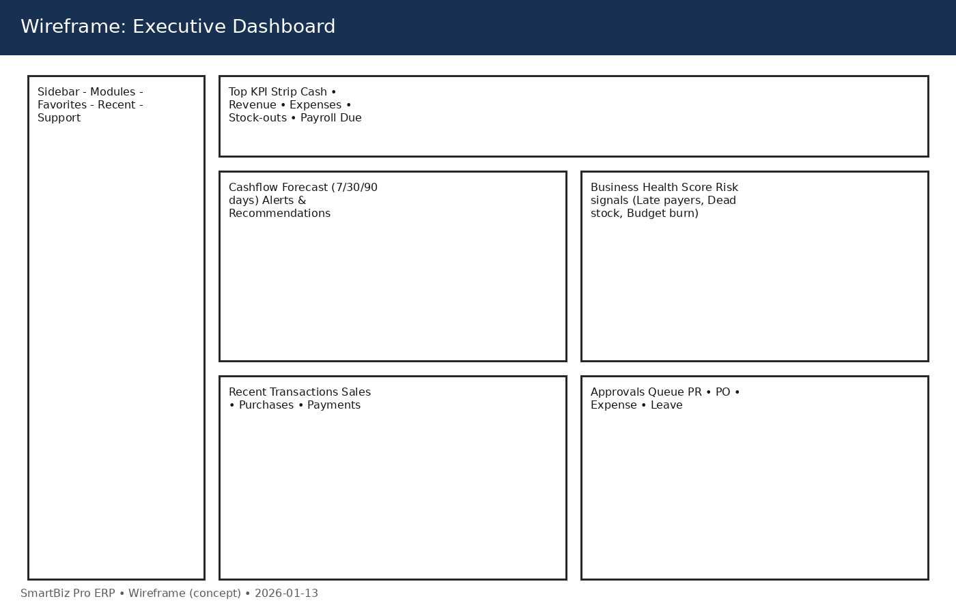
Wireframe: Dashboard

Slide 7
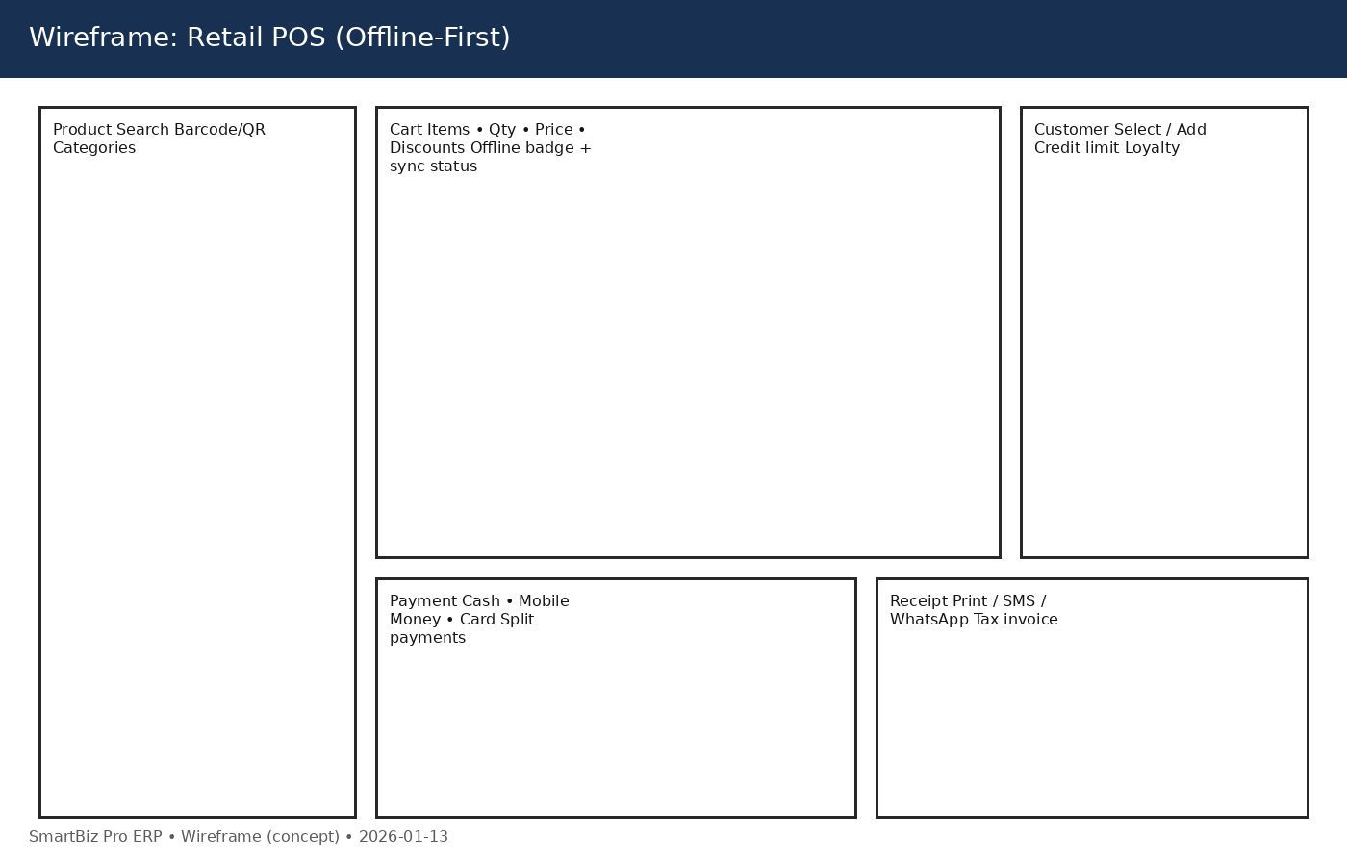
Wireframe: POS

Slide 8
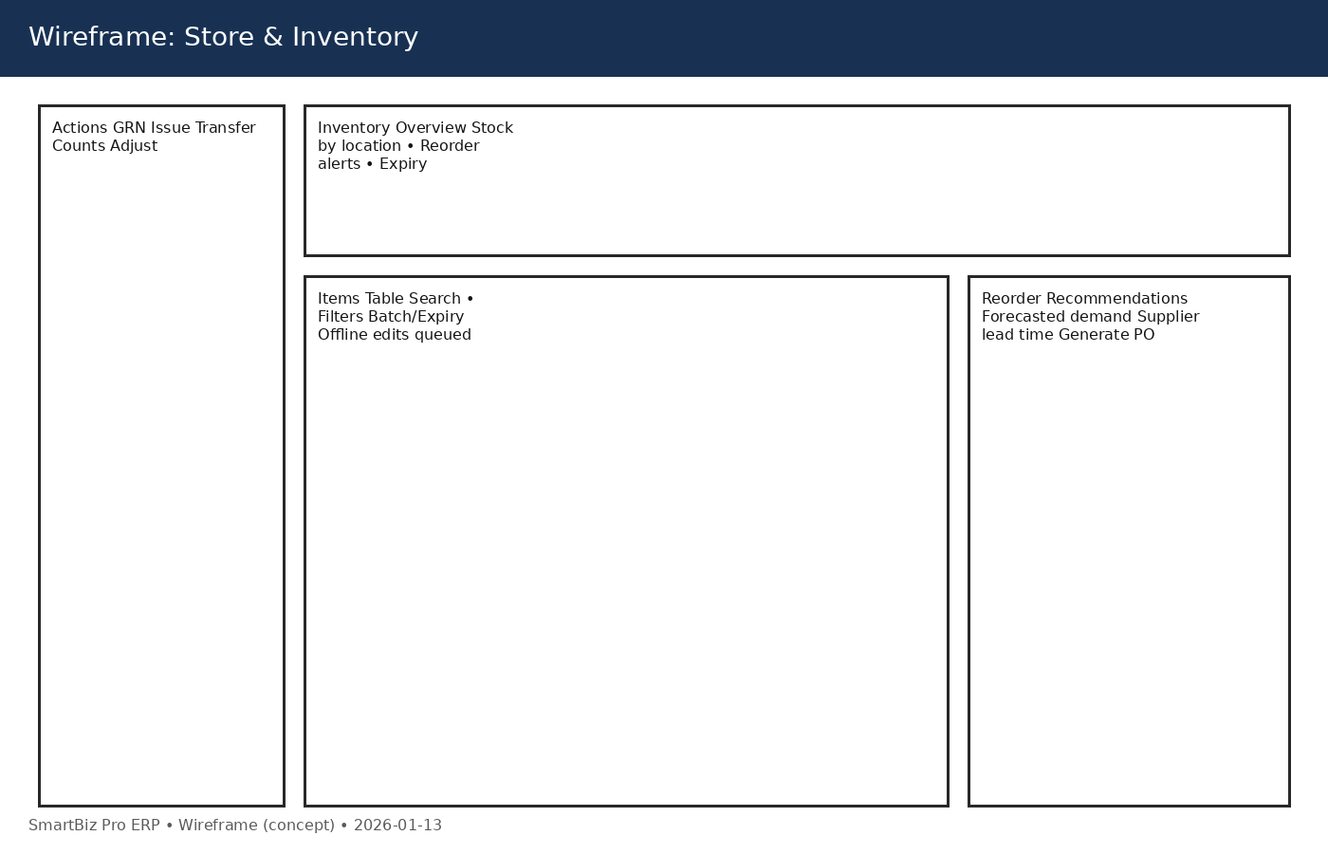
Wireframe: Inventory

Slide 9
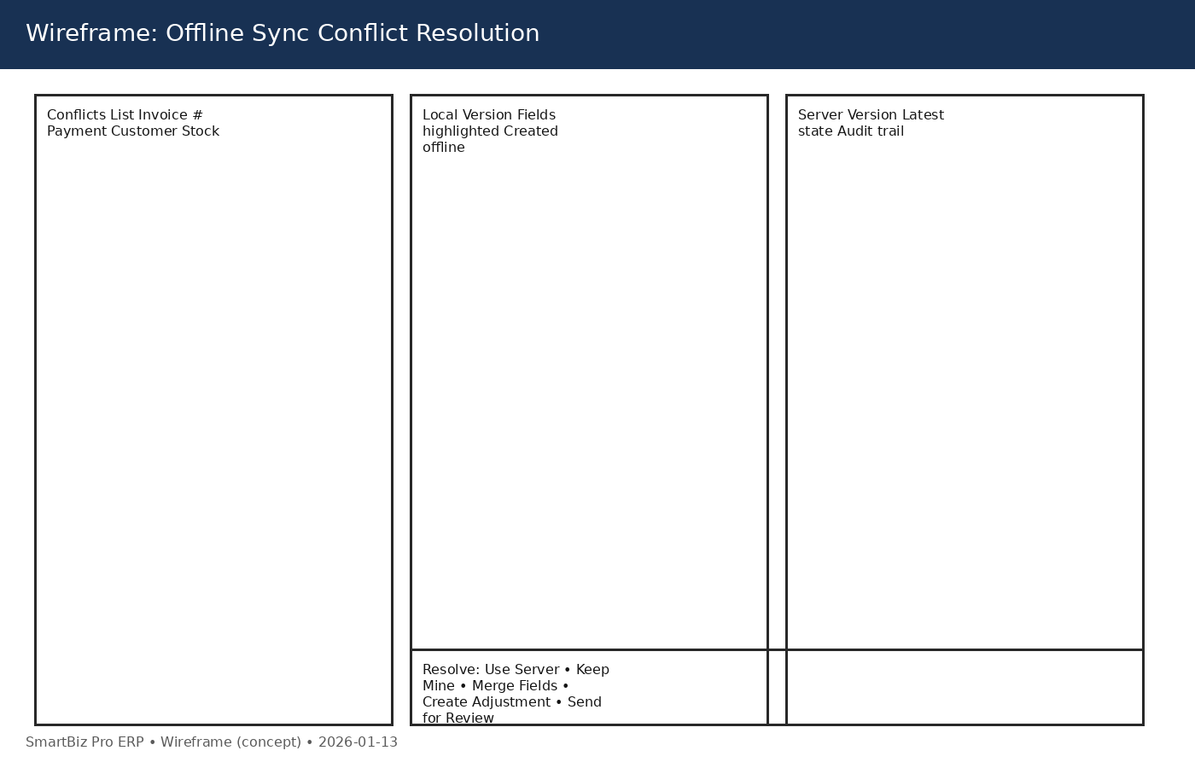
Wireframe: Conflicts

